Slide 1
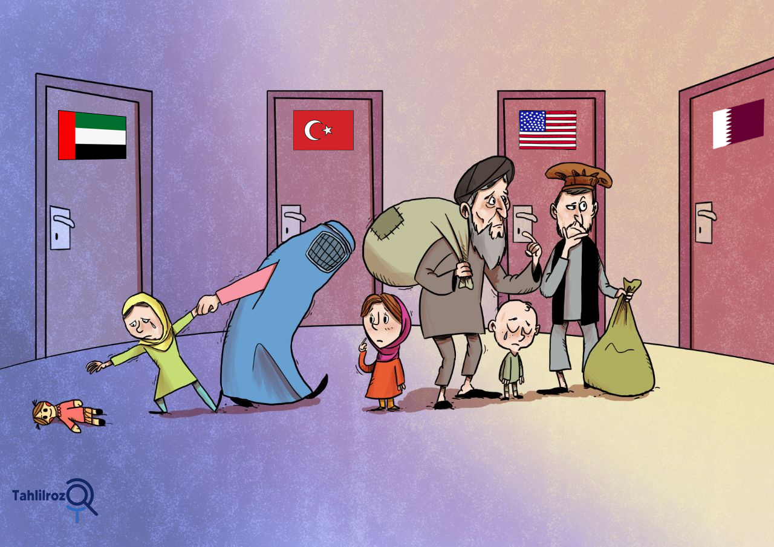
Refugee Identity Management System
by Moubani Sen

Slide 2

Introduction
Background and Context: The global refugee crisis underscores the need for efficient identity management solutions.
Problem Statement: Refugees often lack access to official documents, hindering their access to essential services and support.
Objectives of the Project: Our project aims to address this issue by creating a digital platform for secure and user-friendly refugee identity management.

Slide 3

Methodology
Research and Development Methods: We employed agile software development methodologies, emphasizing continuous testing and user-centered design principles.
Data Collection Techniques: Data was gathered through interviews, surveys with refugees and aid organizations, and a review of best practices in data security and privacy.
Tools and Technologies: The project leveraged HTML,Node.js, Express, MongoDB, React.js, and biometric authentication libraries to build a secure and efficient identity management system.

Slide 4

System Design
System Architecture: Our system follows a client-server architecture with RESTful API, ensuring scalability and redundancy for reliable performance.
Database Schema: We designed a robust database schema to efficiently manage user data, documents, and biometrics, optimizing data retrieval.
User Interface Design: The user interface is intuitive and responsive, featuring user-friendly forms and dashboards for administrators and refugees.
Security Features: The system prioritizes data security with encryption, secure authentication, access controls, and regular security audits to ensure user data protection.

Slide 5

Implementation
Development Process: We adopted an agile development approach, utilizing continuous integration and deployment, version control with Git, and test-driven development (TDD) to ensure efficient and reliable development.
Challenges Faced: During implementation, we encountered and successfully addressed various challenges, contributing to the project's robustness.
Key Features: The system boasts key features, including user registration, document uploads, biometric data capture, and advanced authentication mechanisms, ensuring comprehensive identity management for refugees.

Slide 6

Testing and Quality Assurance
Testing Methodologies: Our testing approach included comprehensive unit and integration testing, with an emphasis on test-driven development (TDD) to maintain high software quality.
Test Cases and Results: We meticulously documented test cases, executed them rigorously, and tracked results, ensuring the reliability and stability of the system.
Bug Tracking and Resolution: Any identified issues were systematically logged, prioritized, and resolved, contributing to a robust and user-friendly application.

Slide 7

Results and Findings
System Performance: The system exhibited outstanding performance metrics with high user adoption among refugees and efficient data retrieval for authorized organizations.
User Feedback and Usability Findings: Positive user feedback highlighted the system's ease of use, with minor suggestions for interface enhancements, resulting in high user satisfaction.
Data Security and Privacy Assessment: Rigorous data security measures, including encryption and access controls, ensured compliance with data protection regulations, and no reported data breaches or security incidents.

Slide 8

Discussion
Interpretation of Results: We analyze the achieved results in the context of project objectives, highlighting the alignment between our efforts and the project's initial goals.
Addressing Challenges: We reflect on the challenges faced during implementation and discuss how they were successfully overcome, contributing to the system's success.
Future Enhancements: Consideration is given to potential improvements and future development opportunities that can further enhance the system's capabilities and impact.

Slide 9

Recommendations
Continuous Improvement: To maintain the system's relevance and effectiveness, we recommend ongoing monitoring and improvements, including updates to security protocols and user interface enhancements.
Expansion of Features: Exploring the expansion of system features, such as additional biometric data types or integration with other humanitarian services, can enhance its functionality.
Collaboration: Collaboration with international organizations and agencies can facilitate scaling the system for broader impact and support.

Slide 10
Conclusion
Summary of Outcomes: In conclusion, the project has successfully developed a secure and user-friendly Refugee Identity Management System, addressing the challenges faced by refugees in proving their identity.
Contributions: Our system contributes significantly to the field of refugee identity management, improving access to essential services for displaced individuals.
Impact: It serves as a vital tool for aid organizations and governments to streamline assistance and support for refugees, ultimately making a positive impact on the lives of those in need.

Slide 11


